Slide 1
CLASS 03: BUILD PROGRAM LOGIC(01)
Intro If statement, If-else statement
and program implementation

Slide 2
TYPES OF FLOW CONTROL
SEQUENCE
SELECTION
ITERATION

Slide 3
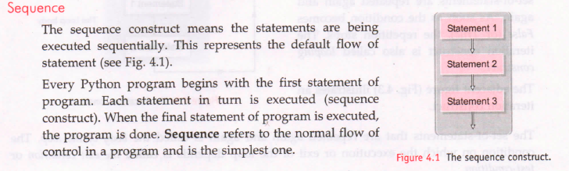

Slide 4
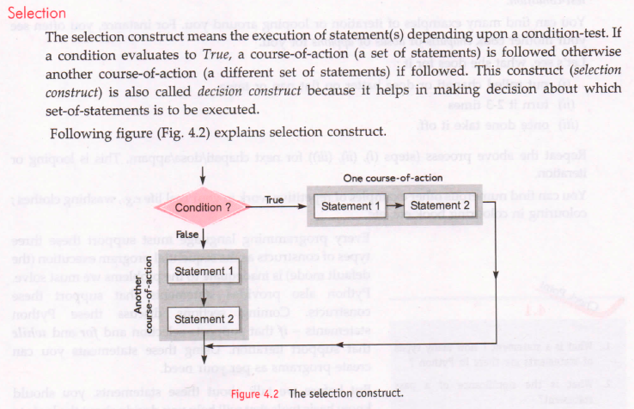

Slide 5
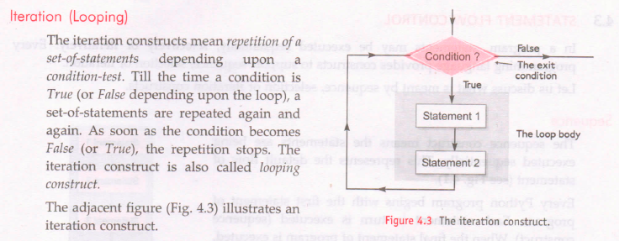

Slide 6
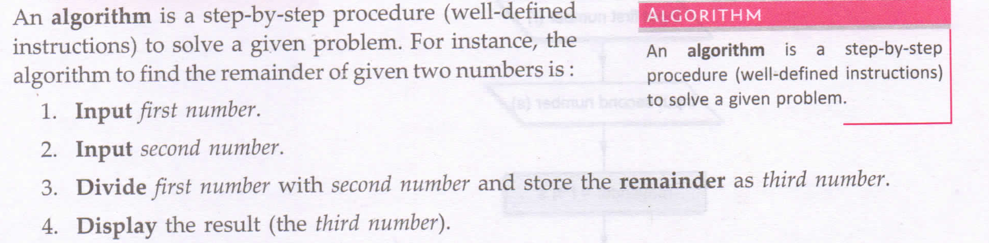
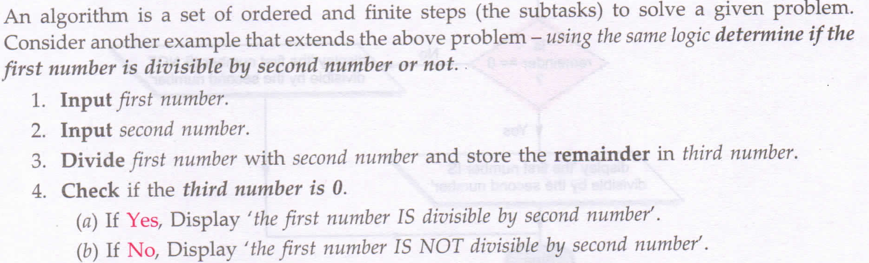
ALGORITHM

Slide 7
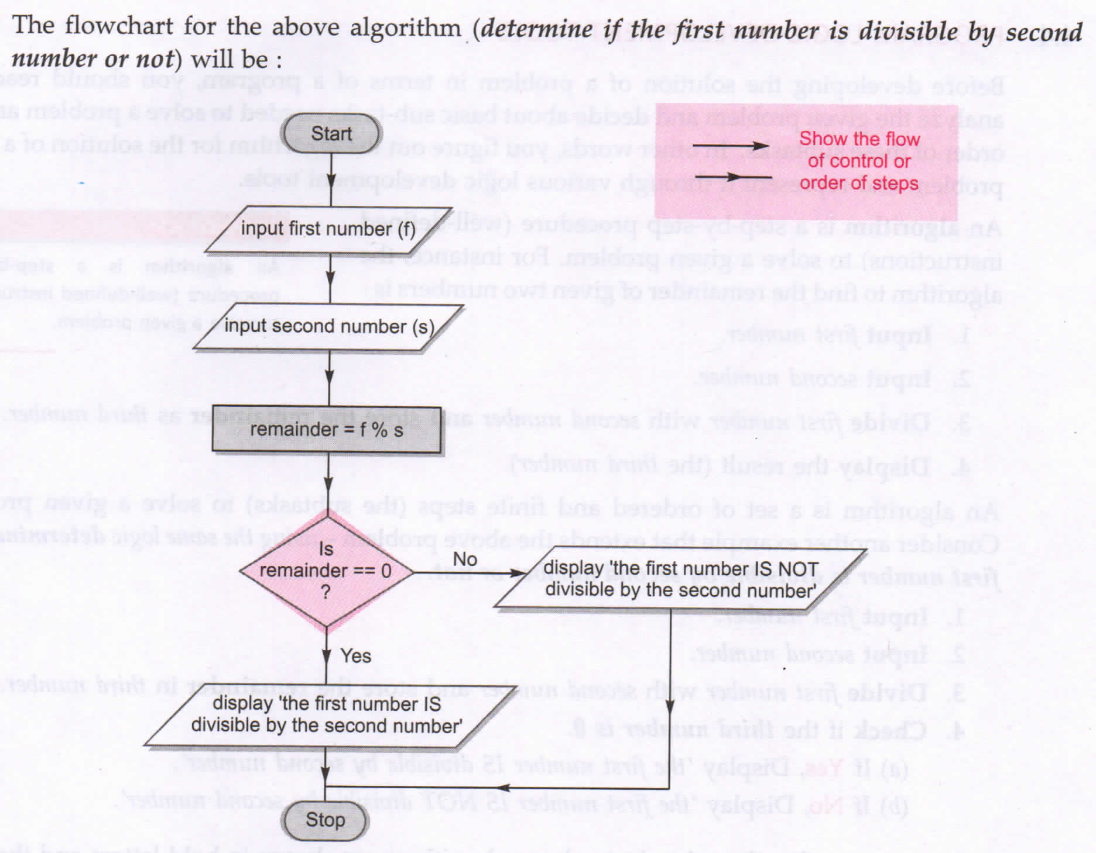

Slide 8
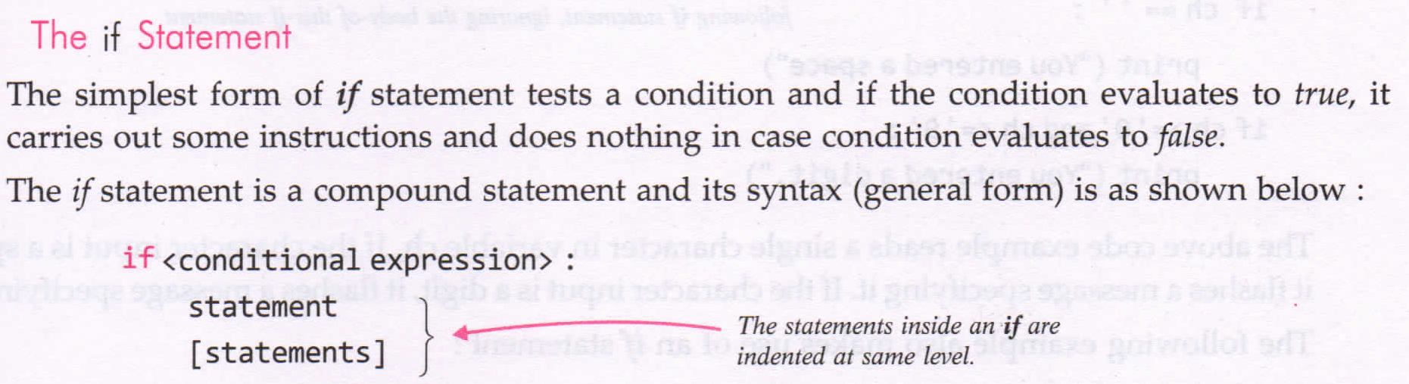
if STATEMENT

Slide 9
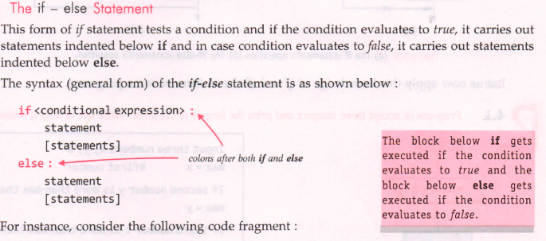
if-else STATEMENT

Slide 10
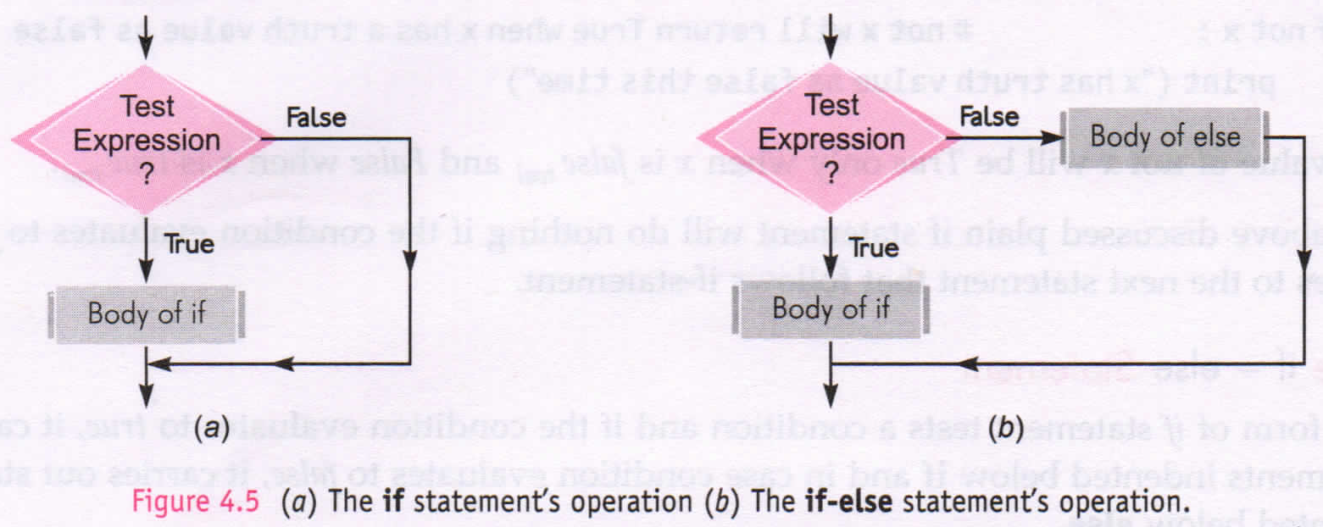

Slide 11
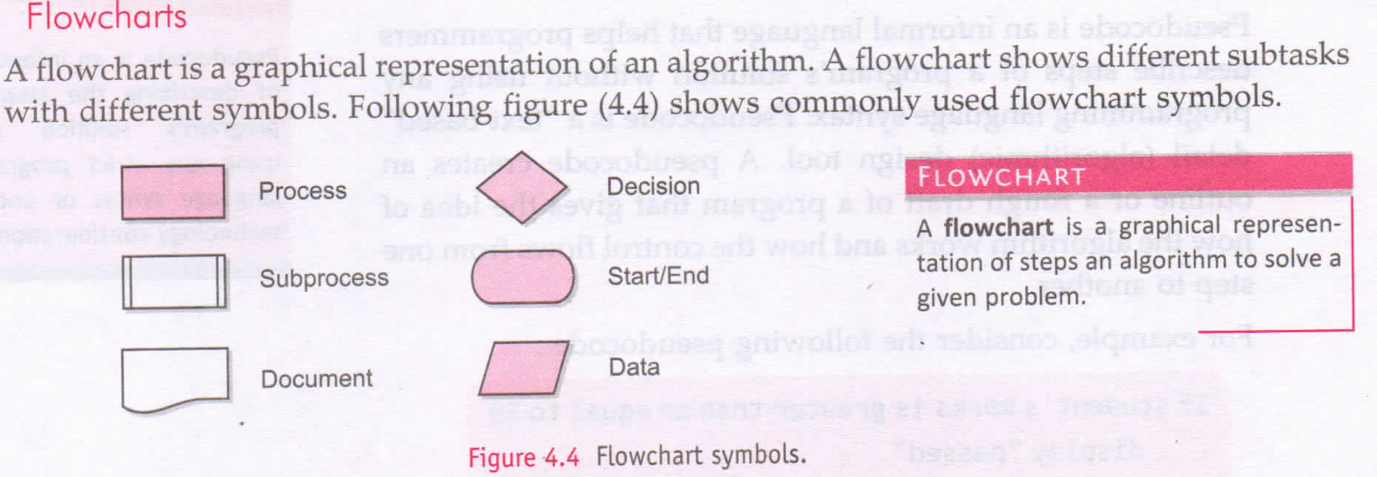

Slide 12
Programs
P1: Program to accept 2 numbers and print the largest among them.
P2: Program to accept 3 numbers and print the largest among them.
P4: Program to test the divisibility of a number with a number.
P5: Program that inputs 3 numbers and calculates two sums as per this: Sum1 as the sum of all input numbers. Sum2 as the sum of non-duplicate numbers; if there are duplicate numbers in the input, ignores them e.g. Input of numbers 2,3,4 will give two sums 9 and 9 Input of numbers 3,2,3, will give two sums as 8 and 2(both 3’s are ignored) Input of numbers 4,4,4 will give wo sums as 12 and 0(all 4’s a re ignored)

Slide 13
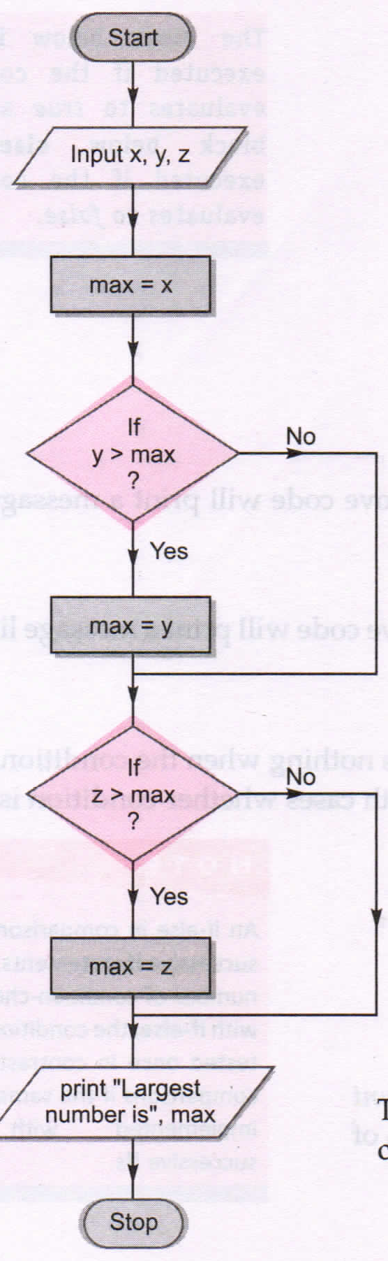
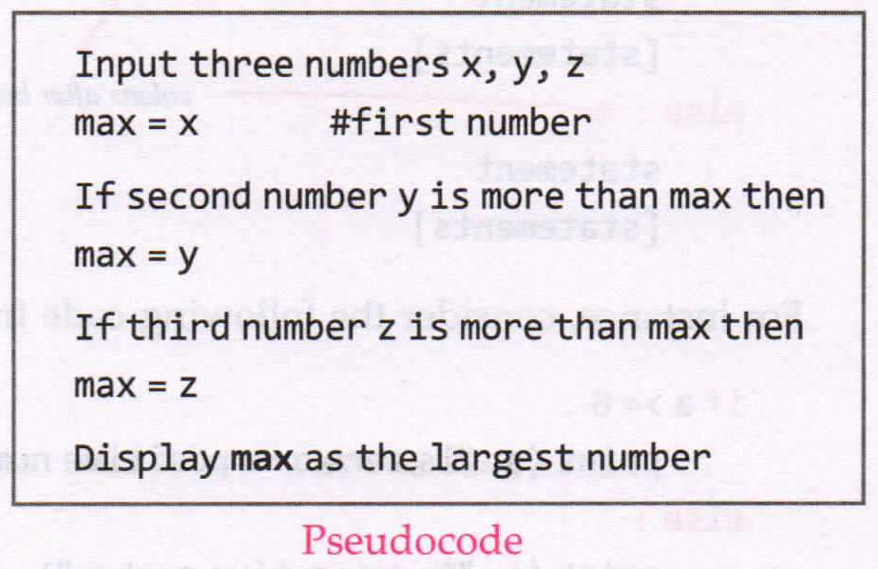
P2

Slide 14
HW Programs
P1: Program to display a menu for calculating area of a circle or a perimeter. Use math.pi for ∏ = 22/7
For Choice = 1 ; calculate Area
For Choice = 2 ; calculate Perimeter
Hint: First take input as radius. Show the choices to the user. Take input user from user for choice. Calculate value as per Choice entered by user and give result as output.
P2: Program that takes a number and checks whether the given number is odd or even.
P3: Program to calculate area and perimeter of a quadrilateral.
For choice 1: Square (side length s)
For choice 2: Rectangle (length l and breadth b)
For choice 3 : Rhombus (diagonals d1 and d2)
If any other choice is entered … give an alert signal

